Slide 1


Department of Computer Science and Engineering
IT23A31 –IOT
Inventory Management System with
Real-Time Stock Reduction and Alerts
MANIKANDAN M -230701174
ELUMALAI - 230701084

Slide 2
ABSTRACT
The Inventory Management System (IMS) presented in this paper is designed to automate the management of stock in a retail environment. The system utilizes real-time stock reduction based on product sales, barcode scanning for easy product identification, and notifications to alert administrators about low stock levels. This web-based system integrates with a database to track product quantities, update stock in real-time, and generate billing information for customers. The primary goal is to improve operational efficiency, reduce errors in inventory tracking, and enhance communication regarding stock levels through automated alerts.

Slide 3
Introduction
Inventory management is a crucial aspect of retail businesses, ensuring that the right amount of stock is available to meet customer demands while minimizing overstock and stockouts. Traditional manual inventory management is prone to human errors, inefficient stock updates, and delayed notifications. This paper proposes a modern, automated inventory management system (IMS) designed to reduce stock in real-time using barcode scanning and provide instant alerts via email when stock levels reach critical thresholds. The system integrates seamlessly with backend databases to manage products and track sales, enhancing both inventory accuracy and business efficiency.

Slide 4
Problem Statement
Traditional inventory management systems often suffer from inaccuracies, delayed stock updates, and lack of timely notifications, leading to overstocking, stockouts, and missed sales opportunities. This paper proposes a real-time Inventory Management System (IMS) that integrates barcode scanning, RFID billing, sensor-based stock monitoring, and email alerts to address these issues efficiently.

Slide 5
Proposed Work
The proposed system is a Real-Time Inventory Management System that uses Arduino Uno for controlling sensors and RFID components. The system tracks inventory levels, automatically updates stock using RFID and ultrasonic sensors, and sends alerts when stock is low. A web application provides a user interface to view and manage the inventory, receive notifications, and generate bills. This system ensures accurate stock management, enhances efficiency, and minimizes human error.

Slide 6
Implementation
Stock Reduction: Real-time inventory update using RFID and sensors when products are sold.
Barcode Scanning: Updates inventory by scanning product barcodes, reducing errors.
RFID Billing: Automatically identifies products and generates accurate bills using RFID tags.
Sensor Monitoring: Tracks stock levels with ultrasonic sensors and alerts when low.
Alerts: Sends low stock emails and triggers buzzer alerts for admin action.
Bill Generation: Automatically generates customer bills based on scanned products.

Slide 7
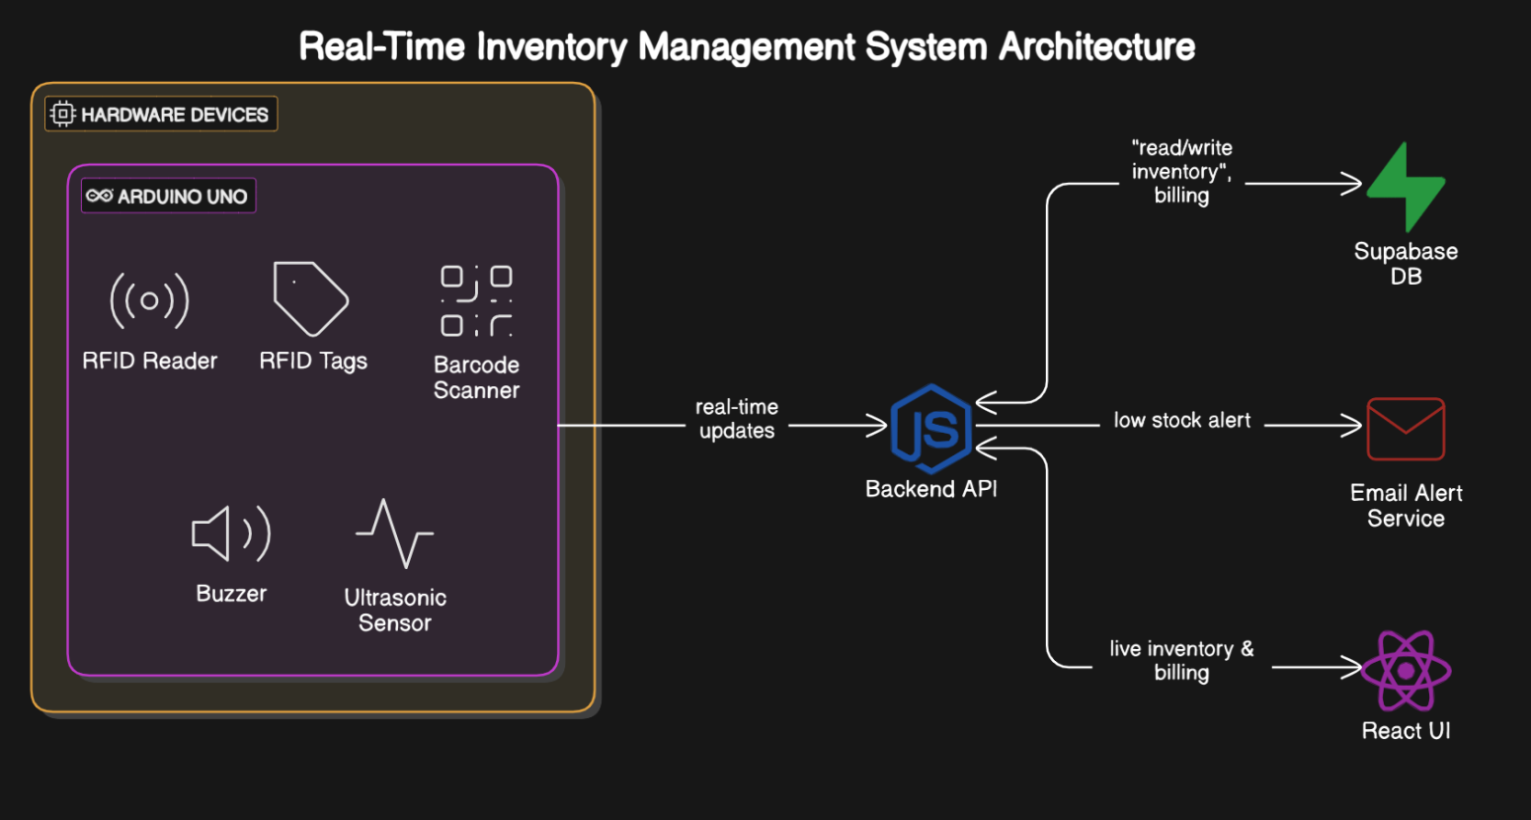
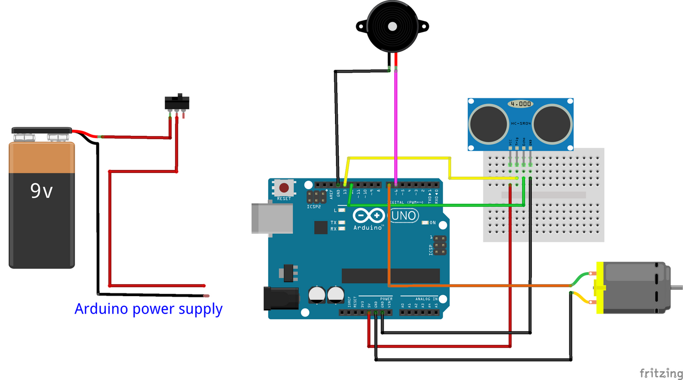
Architecture

Slide 8
System requirements
Arduino UNO
RFID Reader
RFID Tags
Ultrasonic sensors
Buzzer
Power Supply
Jumper wired
Frontend: React.js
Backend: Node.js
Database: Supabase

Slide 9
Advantages of the proposed system
Real-Time Stock Updates: Automatically updates inventory as products are sold.
Barcode Scanning: Simplifies product identification and reduces errors.
Email Alerts: Notifies for low stock to prevent stockouts.
Improved Efficiency: Automates inventory tasks, enhancing service and reducing employee workload.
Bill Generation: Streamlines checkout with accurate billing.
Scalability: Easily expands to manage multiple stores or locations.

Slide 10
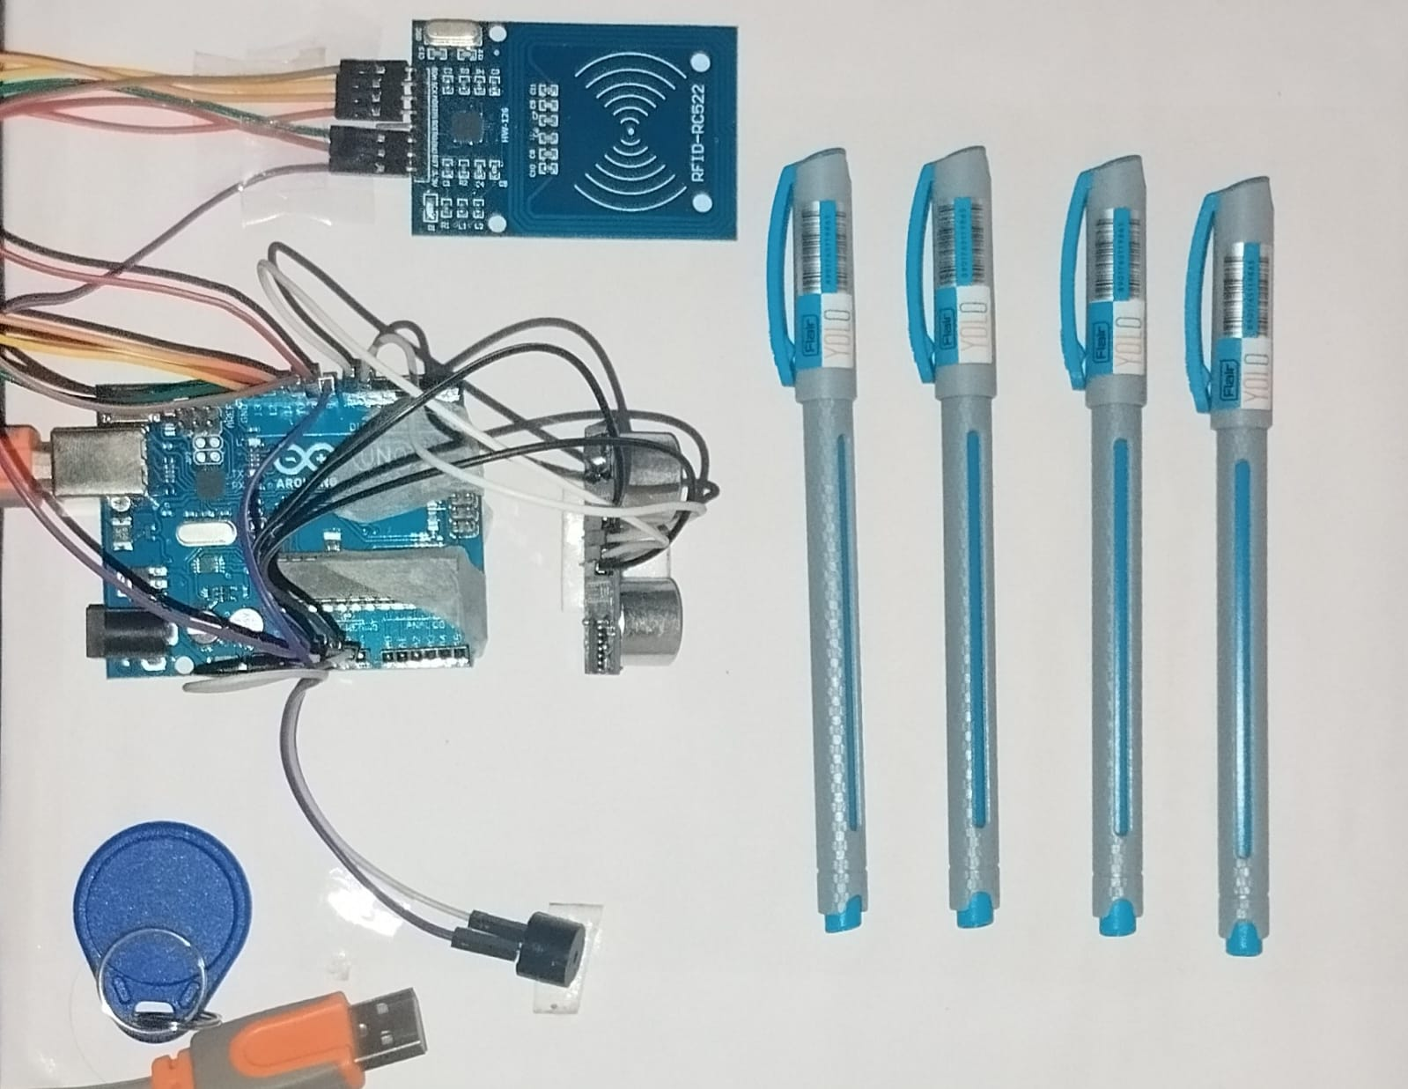
Inventory

Slide 11
Implementation of inventory
Arduino Uno with RFID, sensor, and buzzer detects product removal and low stock.
Sends real-time updates to a Node.js backend connected to Supabase database.
React.js web app displays stock, alerts, billing, and product management.
Bill generation happens automatically after scanning.
alerts are sent when stock is low.

Slide 12
Conclusion
The proposed Inventory Management System provides an effective and automated solution to stock management in retail businesses. By integrating real-time stock reduction, barcode scanning, and email notifications, the system reduces human errors, improves operational efficiency, and ensures that inventory levels are always up to date. This leads to enhanced customer satisfaction and better business performance. Future enhancements could include integrating payment systems, expanding to mobile applications, and providing advanced analytics for inventory forecasting.

Slide 13
References
S. Kumar, "Inventory Management Systems: Challenges and Solutions," International Journal of Business and Management Studies, vol. 9, no. 3, pp. 45-59, 2022.
P. Gupta and S. Sharma, "Automated Inventory Control System," International Journal of Engineering and Technology, vol. 8, no. 7, pp. 72-85, 2021.
A. Smith and B. Thomas, "Barcode Scanning in Retail Management," Journal of Retail and Consumer Services, vol. 34, pp. 101-112, 2019.
S. Lee, "Email Notification Systems for Inventory Management," International Journal of Computer Science and Technology, vol. 10, no. 6, pp. 112-121, 2020.

Slide 14
Thank You

